Slide 1
GIT HUB or Bit Bucket or SVN(SubVersion)
Source Code Management Tools

Slide 2
Content
https://drive.google.com/file/d/1wZMLkiDSjohQ5wedAentouGoRUH2e79f/view
https://drive.google.com/file/d/1dij031NeT6tAFG9z0u5F6VHLbdkNeINu/view
Part 1
Git Hub Registration
Git Bash Client Installation in our system( Local Machine)
Basic CMDs
Create Repository in Github Server
Cloud (Storage ) – by using url we can access data
Git CMDS in Local Machine
How to provide the access to user
How to delete the repo

Slide 3

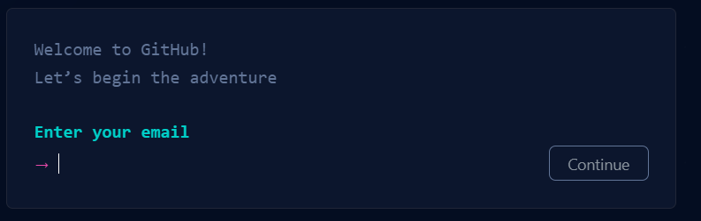
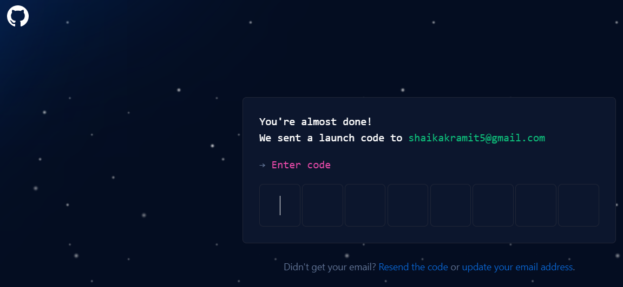
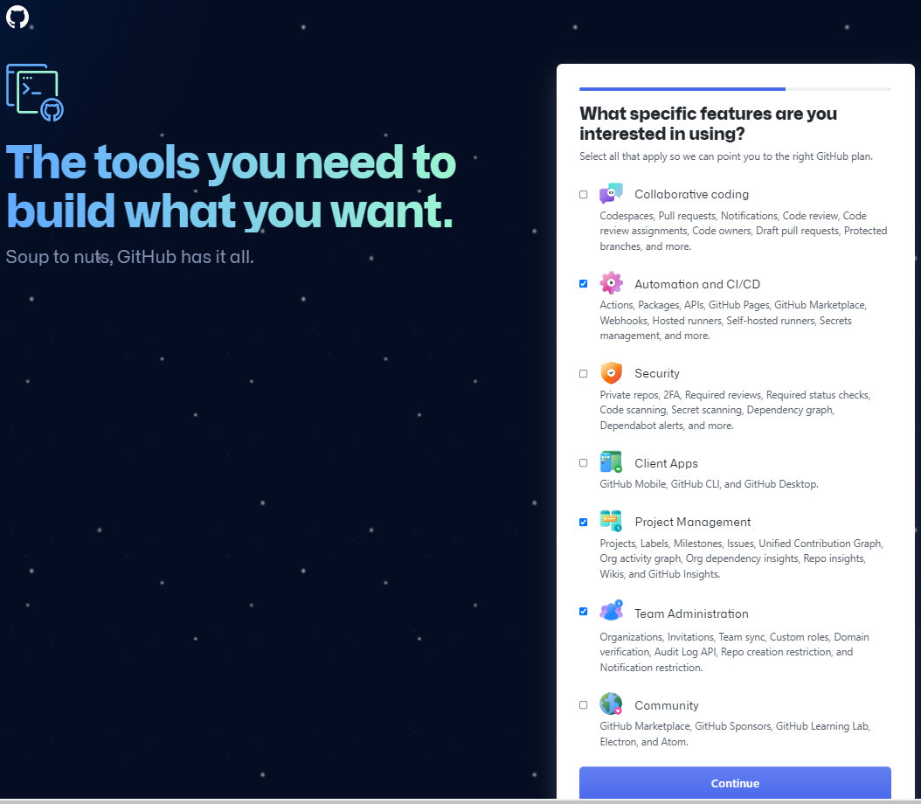
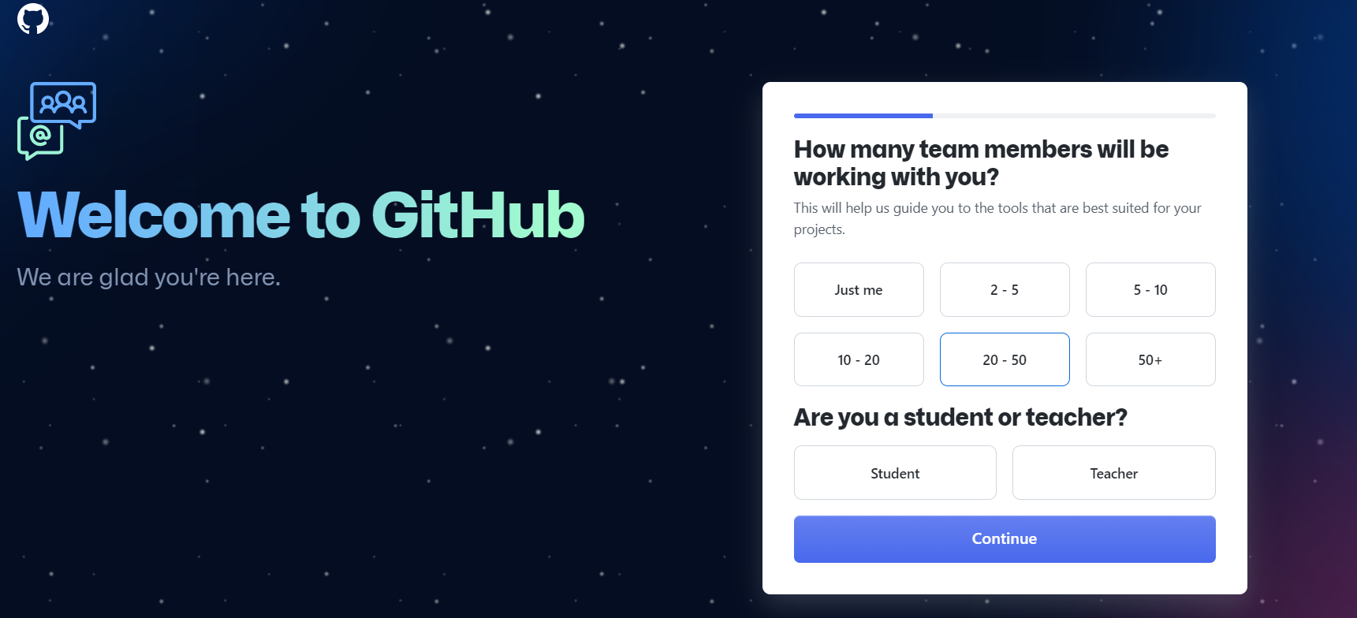
Git Hub Registration Page
Click on Sign up
In Real they will provide repository Details
Enter mail ****@gamil.com
Register the Git Hub Registration Page

Slide 4
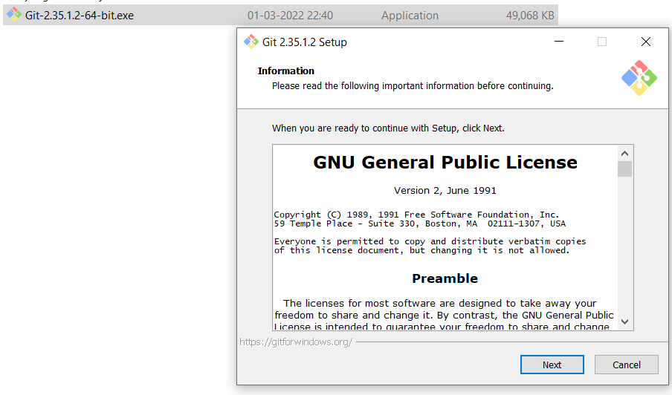
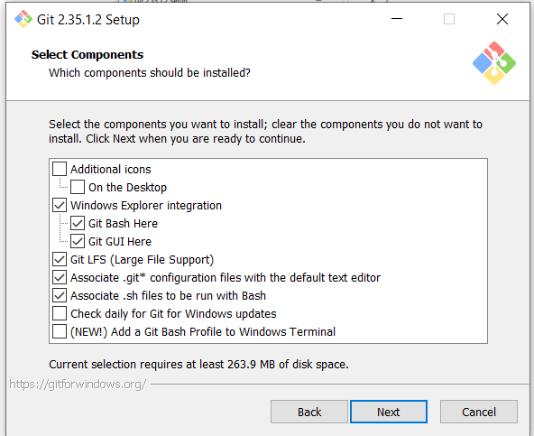
Git Bash Client Installation in our system( Local Machine)
Double Click .exe
Click Next
Click Next
Clink on Next steps and install the Git bash Client in your local machine

Slide 5
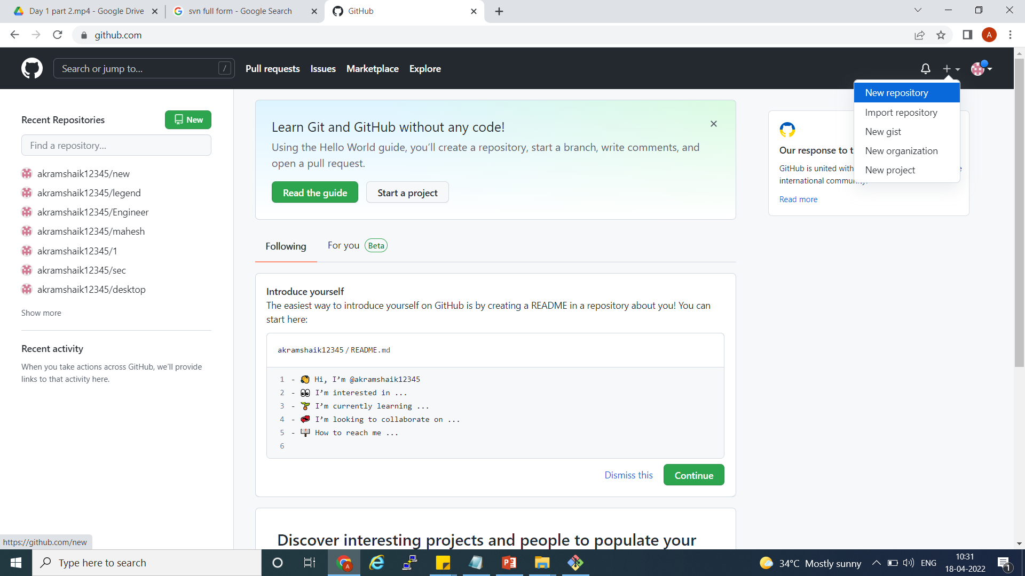
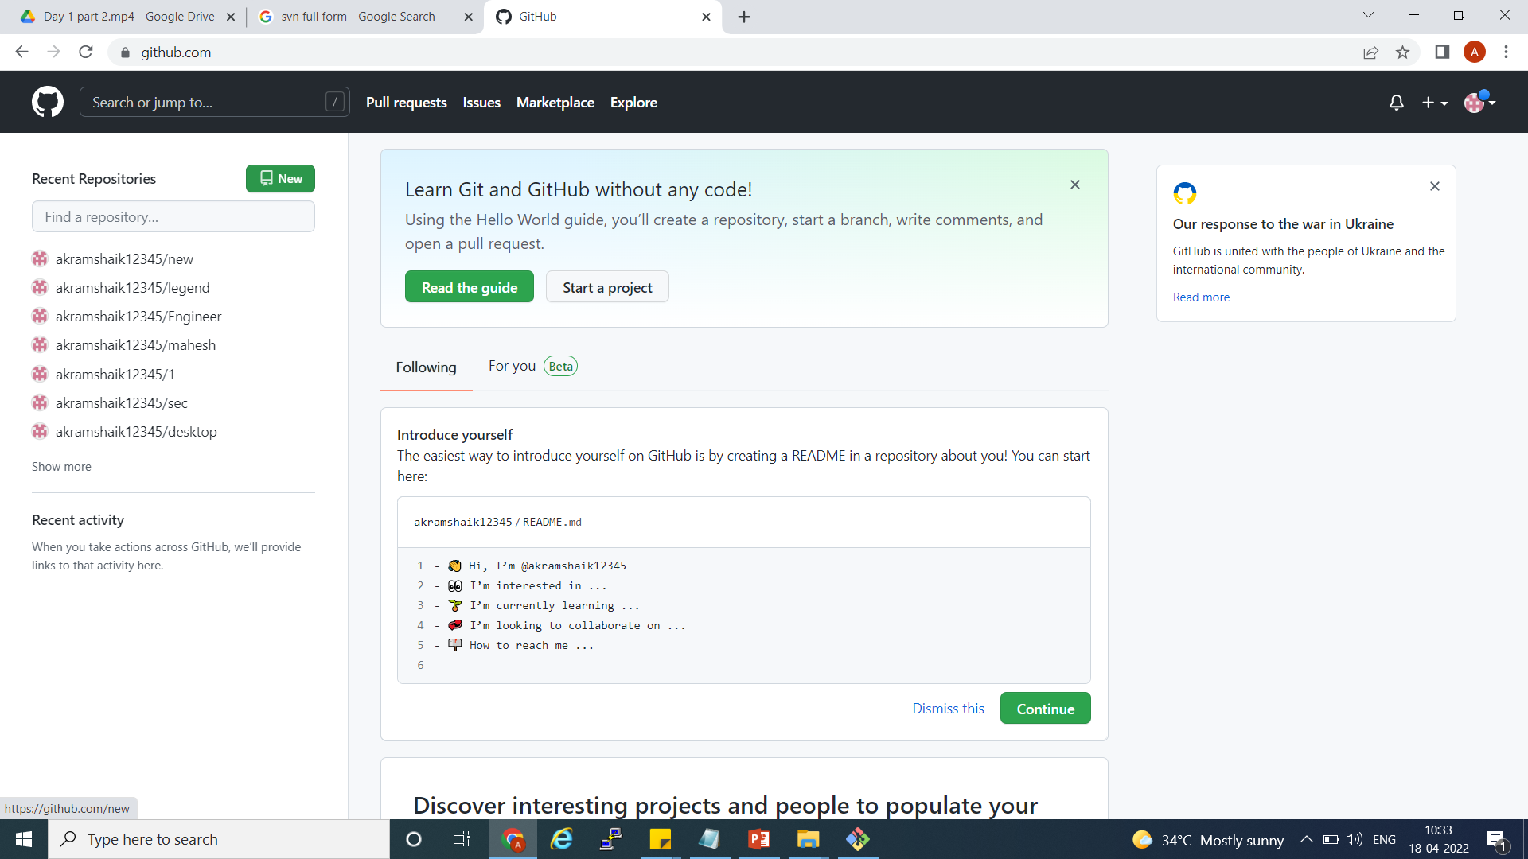
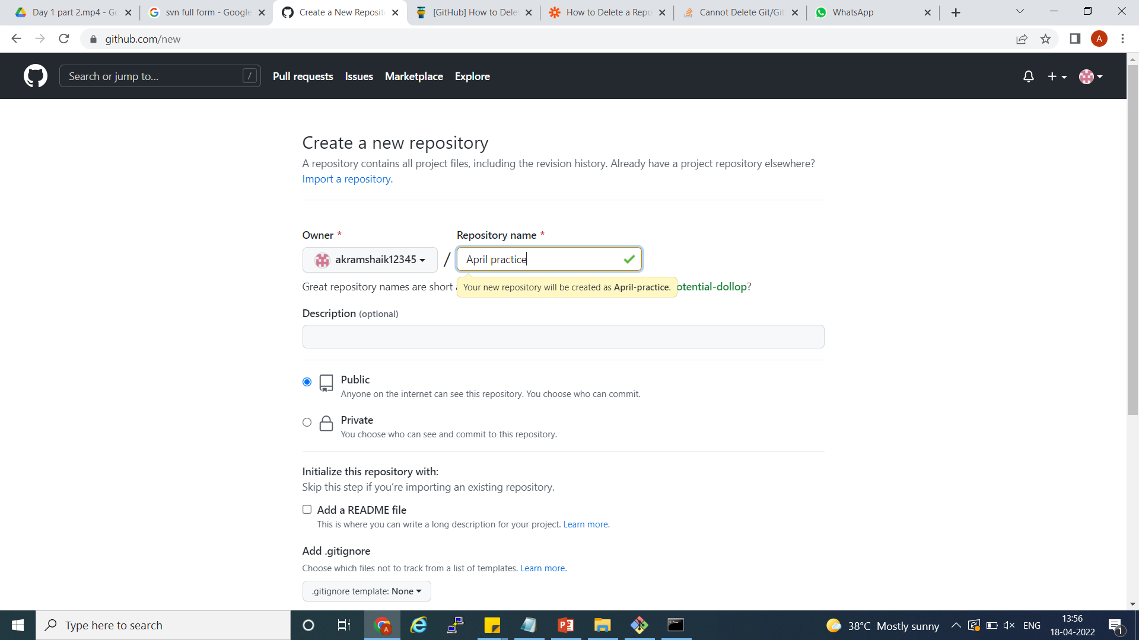
Create Repository in Github Server
OR
Two Ways to create the Repository
If missed to select readme in creating repository . Got to setting page and select the readme file and commit the repository
Any name will for practice but real time as different
Public will see all user
About Readme if unselect
Private will secure the repository
Click on Create Repository

Slide 6
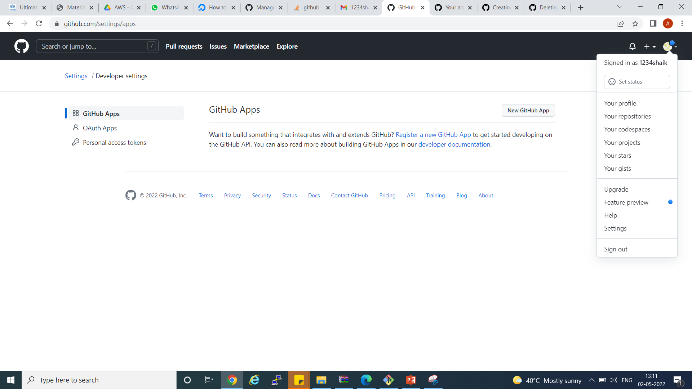
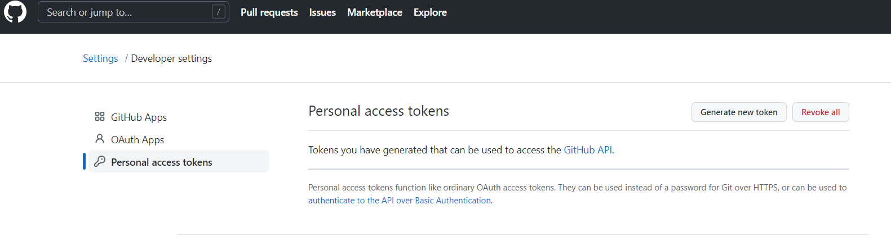
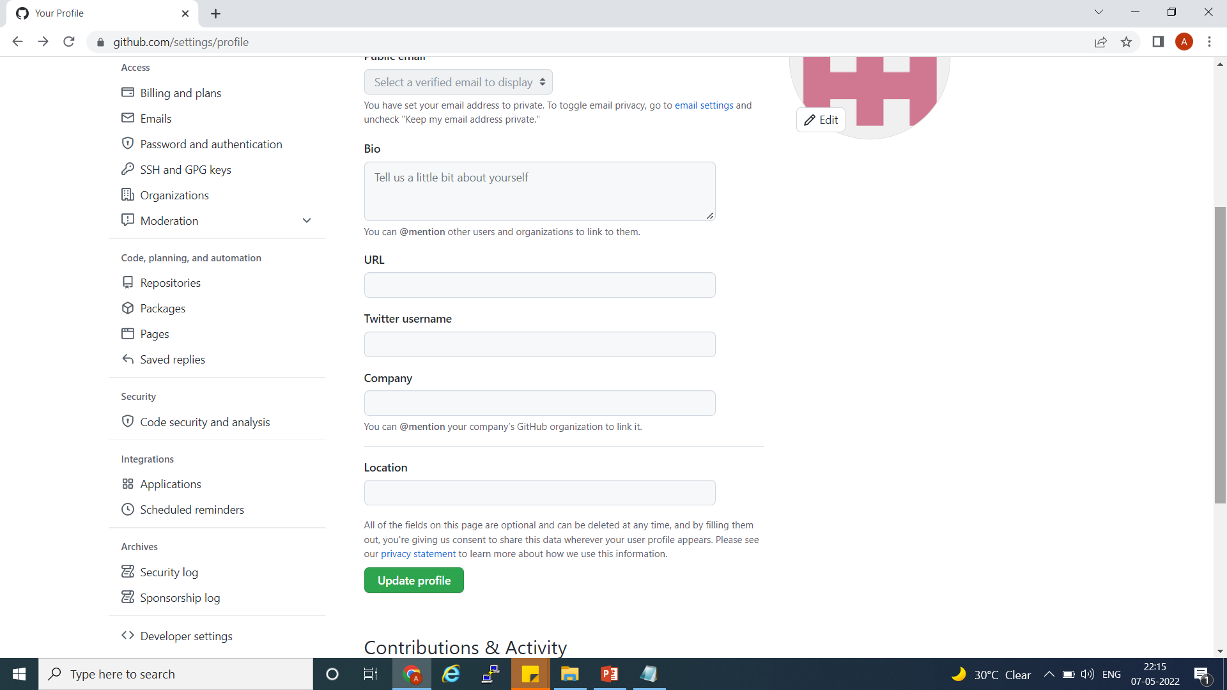
How to provide the access to user
Click tocken
Click to generate token
Click setting
Once access available will push the code to from any user to repo

Slide 7
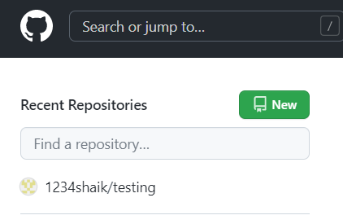
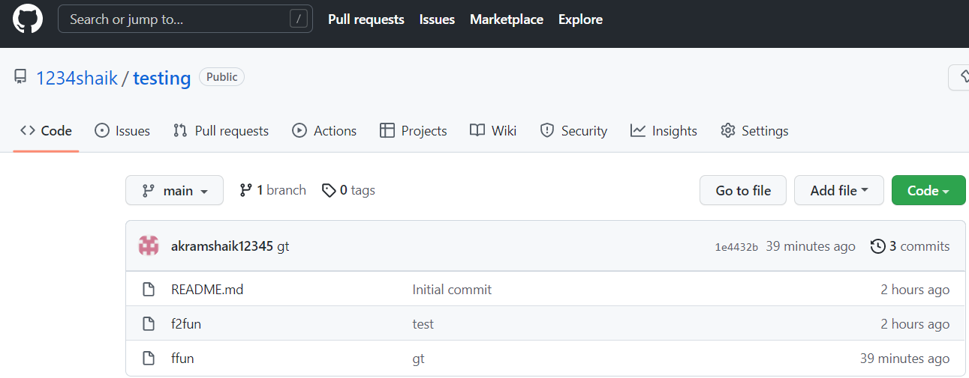
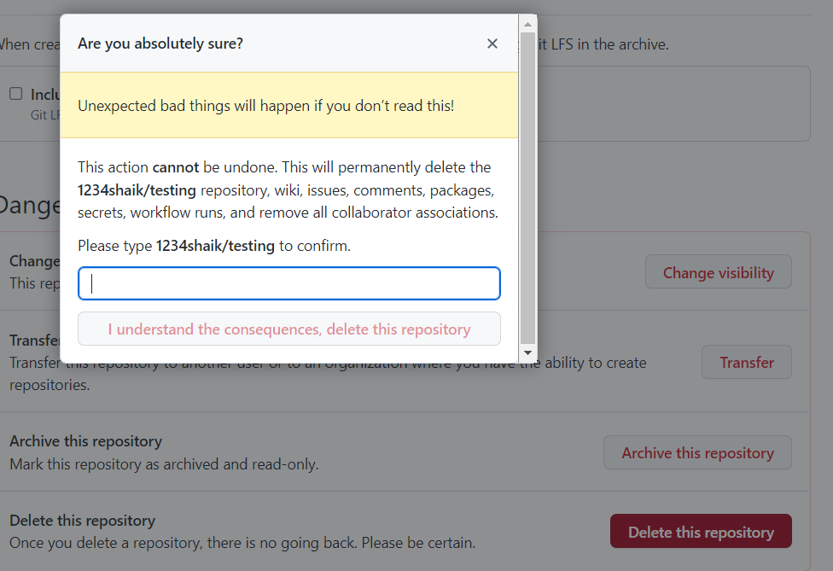
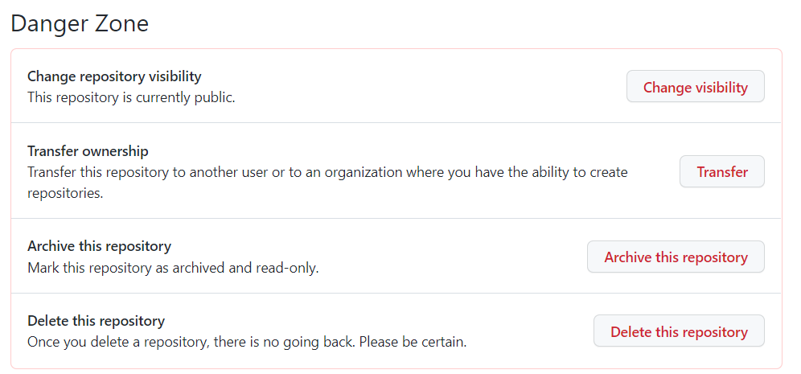
How to delete the repo
Click on setting
Click
Go to Danger Zone
Type the same to confirm
Delete the Repo

Slide 8
GIT , BIT Bucket , SVN – Called As scm tools ( Source code management tools)
Developer project will store in scm.
Git have by default main branch

Slide 9
Developer test the code and store the code in scm.( local repository )
Every repository have url(HHTP , SSH)
Dev - 1
Push
SCM TOOL ( GIT HUB , BITBUCKET, SVN) Store in Repository
Dev -2
Push
Dev -3
Push

Slide 10
Local Machine
GIT HUB
Push the data to Git Hub Repository

Slide 11
Git BASH CMDS
Local Machine
Aslam Shaik@DESKTOP-GJA41R4 MINGW64 ~/Desktop (master)
$ git clone git@github.com:akramshaik12345/April-practice.git
Clone the Repository From GIT HUB Server to Local Machine.
Clone means Download in our LM ( Local Machine )
1
GIT
CMD
Git Hub Repository SSH URL

Slide 12
https://drive.google.com/file/d/17rqwsd6r7piZZa7Q5pZZ082CCVqNrlUQ/view
https://drive.google.com/file/d/1eFrHts3f9K2fSX955SBo3tv63qIXUJ_x/view
Part 2
Local folder to create the repository
Git push
Git pull
Git fetch
How to prod and client that work
How to create the branch

Slide 13
Local folder to create the repository
Aslam Shaik@DESKTOP-GJA41R4 MINGW64 ~/Desktop/New folder (3) (master)
$ cat .git/config
cat: .git/config: No such file or directory
Aslam Shaik@DESKTOP-GJA41R4 MINGW64 ~/Desktop/New folder (3) (master)
$ git init
Initialized empty Git repository in C:/Users/Aslam Shaik/Desktop/New folder (3)/.git/
Aslam Shaik@DESKTOP-GJA41R4 MINGW64 ~/Desktop/New folder (3) (master)
$ ll
total 2425634
-rw-r--r-- 1 Aslam Shaik 197121 2098117127 May 2 11:05 AWS-20220502T052408Z-001.zip
-rw-r--r-- 1 Aslam Shaik 197121 385706064 May 2 10:58 AWS-20220502T052408Z-002.zip
-rw-r--r-- 1 Aslam Shaik 197121 2145 Apr 29 23:32 AWS.txt
-rw-r--r-- 1 Aslam Shaik 197121 5943 May 7 22:58 'DevOps Classes.txt'
drwxr-xr-x 1 Aslam Shaik 197121 0 May 7 23:16 'DevOps PPT'/
-rw-r--r-- 1 Aslam Shaik 197121 550 Mar 19 13:18 'Docker class.txt'
drwxr-xr-x 1 Aslam Shaik 197121 0 May 7 14:01 'IDC Payslip'/
-rw-r--r-- 1 Aslam Shaik 197121 507 Mar 16 12:17 'MVN Class.txt'
drwxr-xr-x 1 Aslam Shaik 197121 0 Apr 12 19:24 'Spatial Tech'/
Aslam Shaik@DESKTOP-GJA41R4 MINGW64 ~/Desktop/New folder (3) (master)
$ cat .git/config
[core]
repositoryformatversion = 0
filemode = false
bare = false
logallrefupdates = true
symlinks = false
ignorecase = true

Slide 14
Git push
Changes in LM will push the Remote repo
Git pull
Latest changes in repo will get the local machine

Slide 15
Git fetch
It will track or downladed the remote changes but it does not reflect the on to your local working directory , to reflect the on to your local working irectory we need to do git merge

Slide 16
How to prod and client that work

Slide 17
How to create the branch
Git Branch Branchname
Git branch
Git checkput branchname
Git push repourl
Git branch –r →show the remote branches
Git branch –a→show local and remote branches
git checkout -b branch → it creat the branch and jump to on the branch

Slide 18
Voice Mismatch
https://drive.google.com/file/d/1ycr4MrkM2-af38jSgvrjbfalM9ywxHBT/view?usp=sharing
https://drive.google.com/file/d/1oeOxWFa78pBqIcF4ZrjLWmD0lVyc-eeF/view?usp=sharing
Part 3
Branch conflicts
How to resolve the conflicts
Git branch merge
How to use cherry-pick
Delete the branch
How to Delete the Branch
Stashing -- 2:00 (2nd url)

Slide 19
How to resolve the conflicts
In Repository same file and same line is developer write some code at that time conflict will occur.
Every changes need to add file and commit.
Local Machine
Another Dev
Touch filename
Git add .
Notepad filename
Git commit –m “conficts”
Git push reponame
Same filename and same line push the code at that time will get conflict
We have to discussed that person and change the line as per suggestion and adjust the our line

Slide 20
Git branch merge
For merger we have to move out of that branch and merger the branch from source to derstination

Slide 21
How to use cherry-pick
Particular commit to move from one branch to another branch
Cherrypick cmd
Note – switch to that branch and enter the cmd
Git cherry-pick commitid
Git push

Slide 22
Stashing
Note – when have another when working on file then only will do stash
Stashing CMDS
Git stash – it will move your changes to stashing area with latest commit message and commit id
Git stash list – show the list of stashids
Git stash pop – it will get back from stashing to local working directory and it will delete the stash entires
Git stash save “message” – it will move the changes to stashing area with custom message
Git stash apply – change from stashing to local working directory and it wont delete the stash entires
Git stash drop stashid – delete the particular stashid
Git stash clear – clear the all stash
Note – when you want to move the file to stashing area that file shoud be in staging area

Slide 23
https://drive.google.com/file/d/1USjmsYVNleQoRLgD5yYbn4ihJqRQE-_N/view?usp=sharing
Part 4
How to Git reset –hard origin/master → it will reset local repo upto the latest pull
How to Git revert commit id →it will delete the changes what you have been committed
How to do the fork → if you want to get repo from one account to another act then we use fork – 13:00
Branch Strategy – 20:00 (high imp)
Pull request for reviewers – 23:00
Branch Protection Rules – 26:50
Git Tags – 28:50 ( push the origin tagname)
Access repo to any one – 18:00

Slide 24
Branch Strategy
When we got requirement initially we are not directly push the dev branch we are create the new branch dev branch is called future branch so we are working in future branch once the work is done future branch we are going raise the pull request dev then that will be approval the respective leads once it done so we are going to merge dev branch if it every thing fine in dev branch .we are moving our changes from dev to staging . In staging also fine. then we are going to move the prepod to prod.
dev
Stagging
Pre=pod
PROD
Future branch

Slide 25
Clone the url
How to Git reset –hard/repo → it will reset local repo upto the latest pull
Aslam Shaik@DESKTOP-GJA41R4 MINGW64 ~/Desktop/New folder (3)/DevOps PPT/Engineer (main)
$ cat e1
e1 created
hi how is this github practice
good do practice more to understanding
done changes
doing
Aslam Shaik@DESKTOP-GJA41R4 MINGW64 ~/Desktop/New folder (3)/DevOps PPT/Engineer (main)
$ cat >> e1
this is checking for git reset --hard orgin/main
Aslam Shaik@DESKTOP-GJA41R4 MINGW64 ~/Desktop/New folder (3)/DevOps PPT/Engineer (main)
$ cat e1
e1 created
hi how is this github practice
good do practice more to understanding
done changes
doing
this is checking for git reset --hard orgin/main
Aslam Shaik@DESKTOP-GJA41R4 MINGW64 ~/Desktop/New folder (3)/DevOps PPT/Engineer (main)
$ git reset --hard origin/main
HEAD is now at 66ddb1b Update e1
Aslam Shaik@DESKTOP-GJA41R4 MINGW64 ~/Desktop/New folder (3)/DevOps PPT/Engineer (main)
$ cat e1
e1 created
hi how is this github practice
good do practice more to understanding
done changes
doing
Aslam Shaik@DESKTOP-GJA41R4 MINGW64 ~/Desktop/New folder (3)/DevOps PPT (master)
$ git clone https://github.com/akramshaik12345/Engineer.git
Cloning into 'Engineer'...
remote: Enumerating objects: 24, done.
remote: Counting objects: 100% (24/24), done.
remote: Compressing objects: 100% (17/17), done.
remote: Total 24 (delta 6), reused 7 (delta 1), pack-reused 0
Receiving objects: 100% (24/24), done.
Resolving deltas: 100% (6/6), done.
Aslam Shaik@DESKTOP-GJA41R4 MINGW64 ~/Desktop/New folder (3)/DevOps PPT (master)
$ ll
total 2291
-rw-r--r-- 1 Aslam Shaik 197121 30327 Apr 27 09:23 AWS.pptx
drwxr-xr-x 1 Aslam Shaik 197121 0 May 7 14:14 Engineer/
-rw-r--r-- 1 Aslam Shaik 197121 2108429 May 7 14:06 'GIT HUB.pptx'
-rw-r--r-- 1 Aslam Shaik 197121 197312 May 6 22:26 Jenkins.pptx
-rw-r--r-- 1 Aslam Shaik 197121 165 Apr 27 09:20 '~$AWS.pptx'
-rw-r--r-- 1 Aslam Shaik 197121 165 Apr 16 07:46 '~$GIT HUB.pptx'
-rw-r--r-- 1 Aslam Shaik 197121 165 Apr 18 22:20 '~$Jenkins.pptx'
Aslam Shaik@DESKTOP-GJA41R4 MINGW64 ~/Desktop/New folder (3)/DevOps PPT (master)
$ cd Engineer/
Aslam Shaik@DESKTOP-GJA41R4 MINGW64 ~/Desktop/New folder (3)/DevOps PPT/Engineer (main)
$ ll
total 3
-rw-r--r-- 1 Aslam Shaik 197121 18 May 7 14:14 README.md
-rw-r--r-- 1 Aslam Shaik 197121 12 May 7 14:14 chestha.txt
-rw-r--r-- 1 Aslam Shaik 197121 105 May 7 14:14 e1
-rw-r--r-- 1 Aslam Shaik 197121 0 May 7 14:14 g5
Clone folder name
It will reset the changes upto latest pull or commit

Slide 26
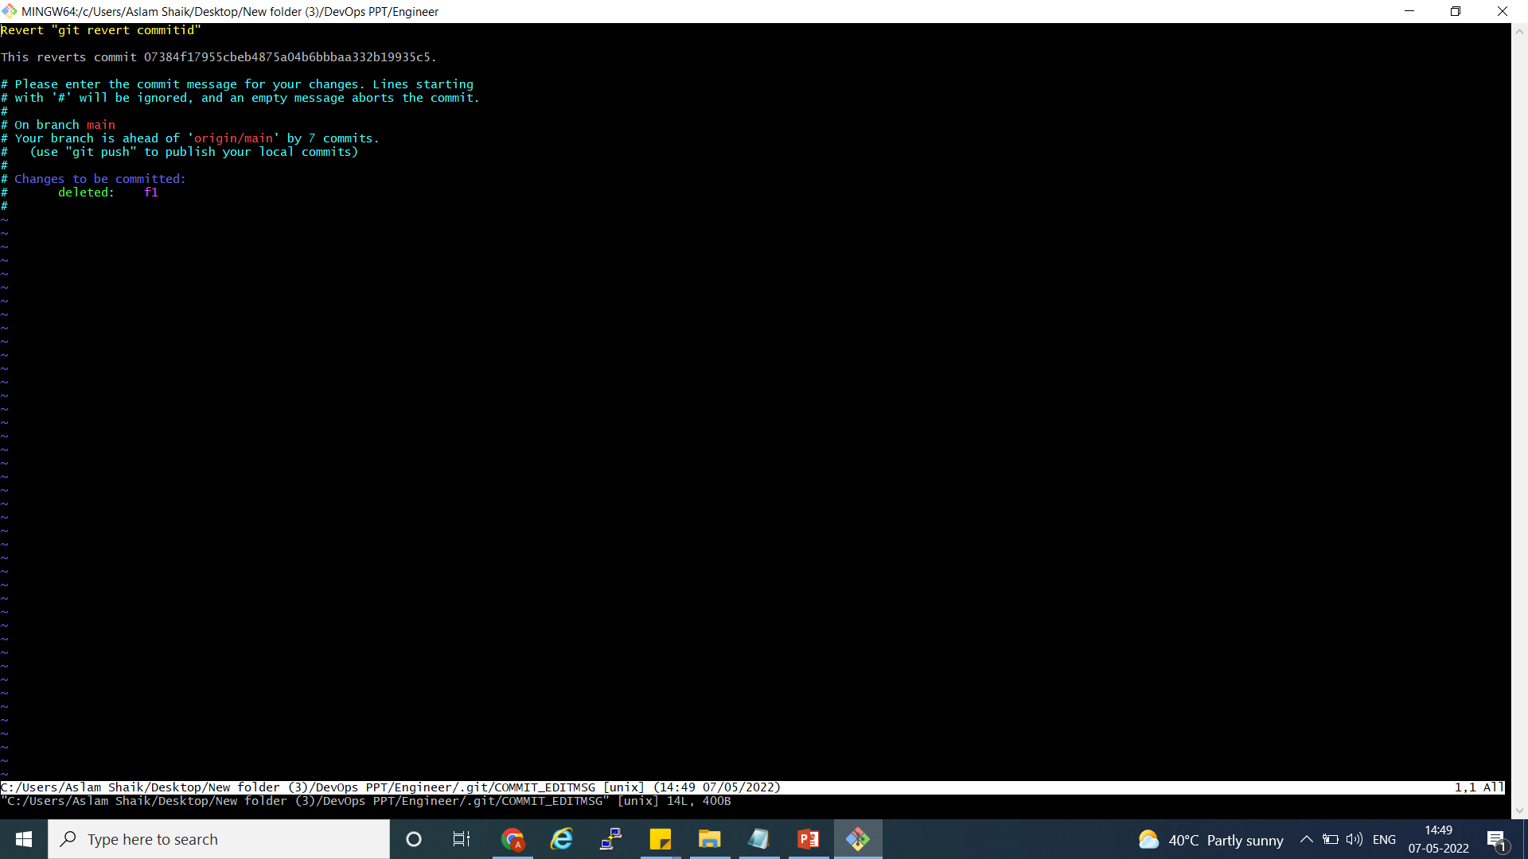

How to Git revert commit id →it will delete the changes what you have been committed
Aslam Shaik@DESKTOP-GJA41R4 MINGW64 ~/Desktop/New folder (3)/DevOps PPT/Engineer (main)
$ ll
total 3
-rw-r--r-- 1 Aslam Shaik 197121 18 May 7 14:14 README.md
-rw-r--r-- 1 Aslam Shaik 197121 12 May 7 14:14 chestha.txt
-rw-r--r-- 1 Aslam Shaik 197121 105 May 7 14:47 e1
-rw-r--r-- 1 Aslam Shaik 197121 0 May 7 14:14 g5
Aslam Shaik@DESKTOP-GJA41R4 MINGW64 ~/Desktop/New folder (3)/DevOps PPT/Engineer (main)
$
Aslam Shaik@DESKTOP-GJA41R4 MINGW64 ~/Desktop/New folder (3)/DevOps PPT/Engineer (main)
$ touch f1
Aslam Shaik@DESKTOP-GJA41R4 MINGW64 ~/Desktop/New folder (3)/DevOps PPT/Engineer (main)
$ git add . && git commit -m "git revert commitid"
[main 07384f1] git revert commitid
1 file changed, 0 insertions(+), 0 deletions(-)
create mode 100644 f1
Aslam Shaik@DESKTOP-GJA41R4 MINGW64 ~/Desktop/New folder (3)/DevOps PPT/Engineer (main)
$ git log
commit 07384f17955cbeb4875a04b6bbbaa332b19935c5 (HEAD -> main)
Author: akramshaik12345 <akramshaikccna@gmail.com>
Date: Sat May 7 14:49:04 2022 +0530
git revert commitid
Aslam Shaik@DESKTOP-GJA41R4 MINGW64 ~/Desktop/New folder (3)/DevOps PPT/Engineer (main)
$ git revert 07384f17955cbeb4875a04b6bbbaa332b19935c5
[main 5f7aaa1] Revert "git revert commitid"
1 file changed, 0 insertions(+), 0 deletions(-)
delete mode 100644 f1
Aslam Shaik@DESKTOP-GJA41R4 MINGW64 ~/Desktop/New folder (3)/DevOps PPT/Engineer (main)
$ ll
total 3
-rw-r--r-- 1 Aslam Shaik 197121 18 May 7 14:14 README.md
-rw-r--r-- 1 Aslam Shaik 197121 12 May 7 14:14 chestha.txt
-rw-r--r-- 1 Aslam Shaik 197121 105 May 7 14:47 e1
-rw-r--r-- 1 Aslam Shaik 197121 0 May 7 14:14 g5
git revert 07384f17955cbeb4875a04b6bbbaa332b19935c5
It delete the changes with comit id

Slide 27
Pull request for reviewers

Slide 28
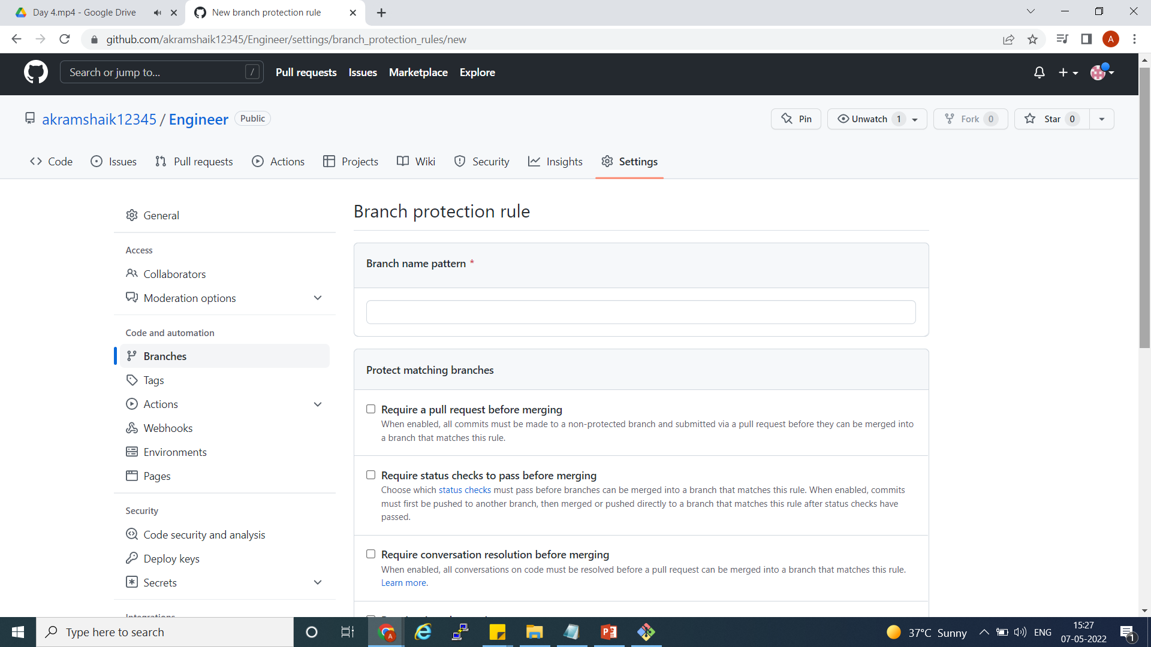
Branch Protection Rules

Slide 29
https://drive.google.com/file/d/1sf9_enBZTWAOV-lk-eQW3XjNQ1NcUOLy/view?usp=sharing
Part 5

Slide 30
Git Bash CMDs
Add File Git CMDs
Git Clone repourl
Touch File name
Git add .
Git commit –m “message”
Git push repourl
To create a file by using touch cmd(touch filename)
Git status ( to check every stage)
Branch CMDS
Add Branch Git CMDs
Git branch Branchname(list)
Git branch
Git checkout Branchname(list)
Git Push repourl
Git Branch BranchName
Git Checkoput branchName
git push --delete origin branchname – delete the remote repo
Git Branch –D branchname – delete branch in local system
Git log –oneline – will get commit id dispectration
Git rebase –i HEAD-5 – last commit will it
Git rebase –abort – rebase session w
Git Pull
Git remote add orgin repo
cat .git/config

Slide 31
How to change the private to public
On GitHub.com, navigate to the main page of the repository.
Under your repository name, click Settings.
Under "Danger Zone", to the right of to "Change repository visibility", click Change visibility.
Select a visibility.

Slide 32
Srikanth develops clases
https://drive.google.com/file/d/1nYE80mCe92PF_wNDyAjONLCdjkm3VvsA/view
https://drive.google.com/file/d/1E72dp0fDnfwfqOUQfGnJ1IaqyoGzGm1K/view
Rebase in 2nd url

